Slide 1

“resQSquad”
Presented By:
Ankit Kumar(1VE21CS014)
Ankit Singh(1VE21CS015)
Atul Yadav(1VE21CS024)
Guided By:
Sridevi N
Assistant Professor
Dept. of CSE, SVCE

Slide 2
Problem statement
A Platform under which all rescue agencies are registered and which can display the location of other rescue relief agencies during natural/man-made calamities

Slide 3
Introduction
We have a technological solution for this which is resQSquad.
Our digital solution consists of creating a centralized platform where all the authenticated users like Rescue Agencies NGOs and other organizations are registered.
They can see each other’s location and can collaborate well during a disaster or any calamity.

Slide 4
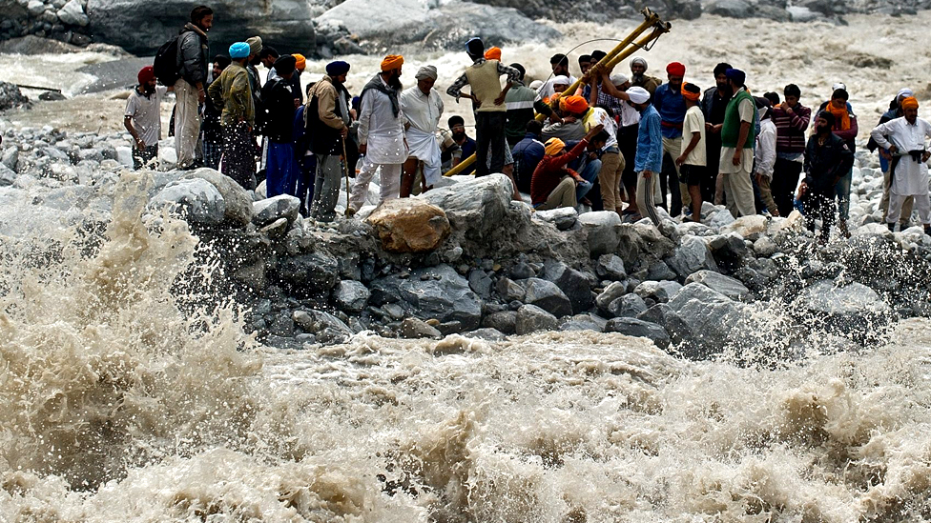
Purpose of the resQSquad
To safeguard lives and property by providing timely and accurate information regarding potential and ongoing disasters.
To empower communities to prepare for, respond to, and recover from disasters through timely information dissemination.
To offer immediate rescue assistance to individuals in distress during disaster situations.

Slide 5
APPRPRIATNESS OF THE SCOPE:
To facilitate registration of organizations, enable distress signals from rescue teams, and match available resources with disaster-affected areas.
To create a database of organizations with diverse capabilities for potential rescue and support operations.
To optimize the deployment of rescue teams and support personnel based on proximity to the affected area.

Slide 6
OVERVIEW OF PROJECT
BACKGROUND : No such app which provide help during a disaster is present. Only warning apps are there which gives alert at the time of disaster like
GEEWS(Gujarat Early Earthquake Warning System),
NDMA (National Disaster Management Authority) App
DAMINI App : Focuses on lightning alerts, providing real-time warnings about lightning strikes in specific areas.

Slide 7
Key Features
Real-time disaster alerts: Provides instant notifications about ongoing or potential disasters.
Geolocation-based resource mapping: Identifies available rescue teams and support organizations based on proximity to the affected area.
Emergency communication platform: Enables direct communication between rescue teams, affected individuals, and support organizations.
Volunteer management: Facilitates the registration and mobilization of volunteers for disaster response efforts.

Slide 8
LITERATURE REVIEW:
LITERATURE
MAIN IDEA
"The Practice of Emergency and Disaster Medicine: The Basic Concepts” by Gregory R. Ciottone
Critical Incident Stress Management (CISM) by by Jeffrey T. Mitchell and George S. Everly Jr.
"The Resilient First Responder: A Comprehensive Guide to Building Better Mental Health and Well-Being" by Robert P. Douglas.
Disaster Mental Health Services: A Primer for Practitioners" by Diane Myers and Keith W. Norris
Provide medical perspective on disaster response.
A structured approach to managing the psychological impact of critical incidents on responders.
Emphasizes the importance of mental resilience and well-being among first responders.
offering practical advice and strategies for building mental strength.
Provide psychological needs of disaster survivors and responders.

Slide 9
Relevance of resQuad
1. Time-critical: The platform emphasizes rapid response and timely delivery of information and aid.
2 Location-based: The system relies on real-time geolocation data to match resources with needs efficiently.
3 Collaborative: resQSquad fosters collaboration among various organizations to collectively address disaster response.
4 Technology-driven: The project leverages mobile technology and digital platforms to enhance efficiency and accessibility.

Slide 10
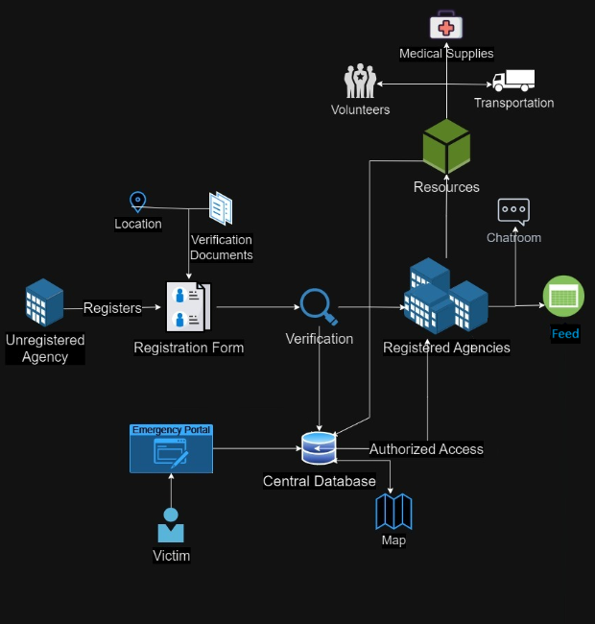
Implementation

Slide 11
Improved disaster response: Faster mobilization of resources and increased efficiency in rescue operations.
Enhanced community resilience: Reduced vulnerability to disasters and accelerated recovery processes.
Result
Outcome

Slide 12
References
Django documentation
Bootstrap
GitHub
Ipinfo
Stackoverflow
Python Documentation
PostgreSQL

